Slide 1
BTP - II (CS47006)
Streamlining Convolutional Neural Networks:
Channel-Level Sparsity for Efficient Compression
By - Nikhil Saraswat (20CS10039)
Supervisor - Prof. Pabitra Mitra

Slide 2
Problem
CNN deployment challenges:
model size
memory
computational complexity
Hinders CNN deployment in real-world applications
Solutions:
Compression
sparsity-inducing techniques etc.

Slide 3
Motivation
Need for further efficiency enhancement by innovative refinement strategies.
Nonconvex regularization techniques (Lp and TL1 penalties) are promising.
Aim for improved performance without compromising accuracy.

Slide 4
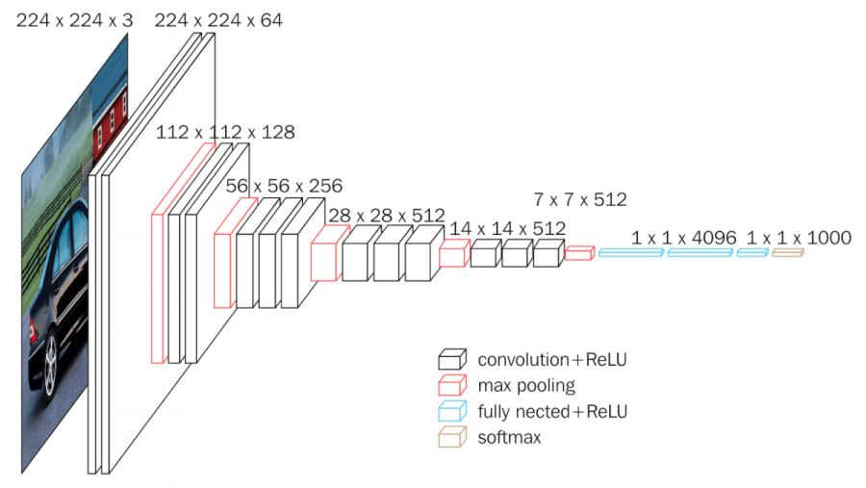
VGG16 Architecture
Effective image classification
Approx. 20.04 M parameters
Figure: Visualization of VGG-16 architecture (link)

Slide 5
Non-convex Penalties
Lp and TL1 boosts sparsity due to their non-convex behavior.
Higher sparsity ⇒ less bias in parameter selection, aiding in accurate pruning.
Fosters continuity, ensuring smoother transitions in parameter magnitudes.

Slide 6

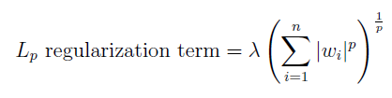

Sparse Regularization
L1 Regularization:
Lp Regularization:
TL1 Regularization:

Slide 7
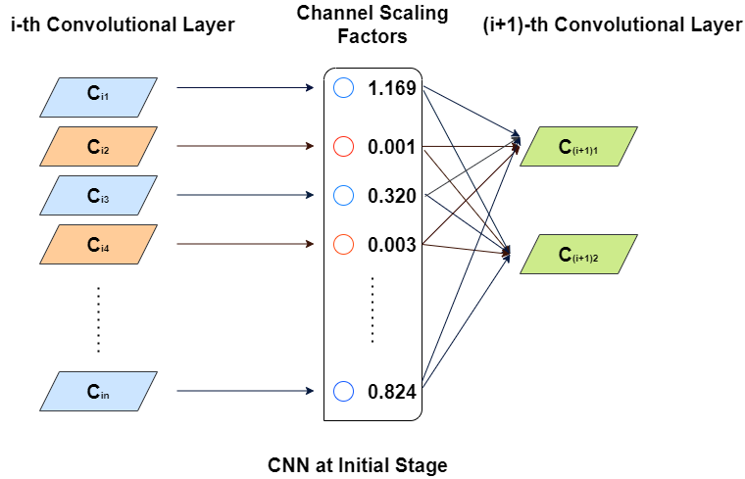
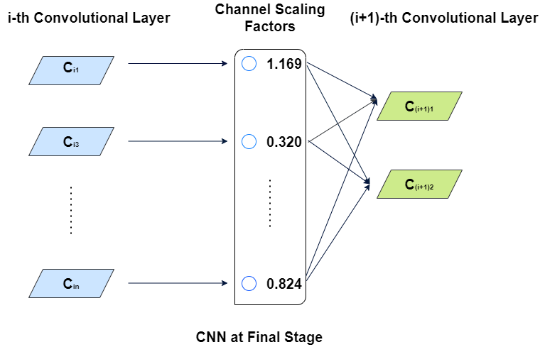
Channel Pruning
Figure: Channel Pruning (link)

Slide 8
Channel-Level Sparsity: Leveraging Scaling Layers
Batch-norm weights as scaling factors
sparsity penalties to update weights
Sort weights by magnitudes
Prune the channels
Set a pruning threshold
Identify channels linked to smaller weights

Slide 9
Re-training/Fine-Tuning for Recovery of Accuracy
The pruned model exhibits reduced accuracy due to the removal of potentially valuable channel information.
Fine-tuning process adjusts the remaining parameters, enabling the model to regain performance comparable to the original, unpruned model.
Initial CNN
Train with channel sparsity regularisation
Prune Channels
Re-train the pruned network
Final compact CNN

Slide 10
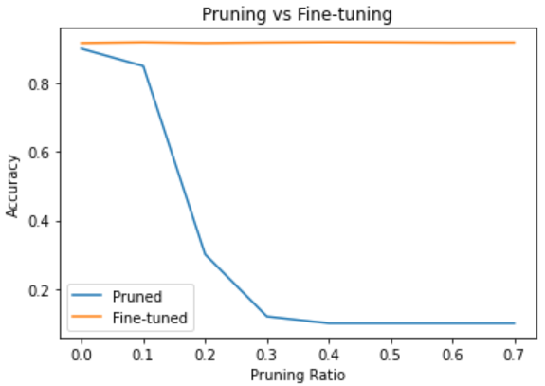
Results on Pruning and Fine-tuning
Pruning % | Pruned Acc. % | Fine-tuned Acc. %
No Pruning | 91.71 | 91.75
10 | 85.01 | 91.97
20 | 30.12 | 91.75
30 | 12.00 | 91.91
40 | 10.00 | 92.01
50 | 10.00 | 91.96
60 | 10.00 | 91.87
70 | 10.00 | 91.90

Slide 11
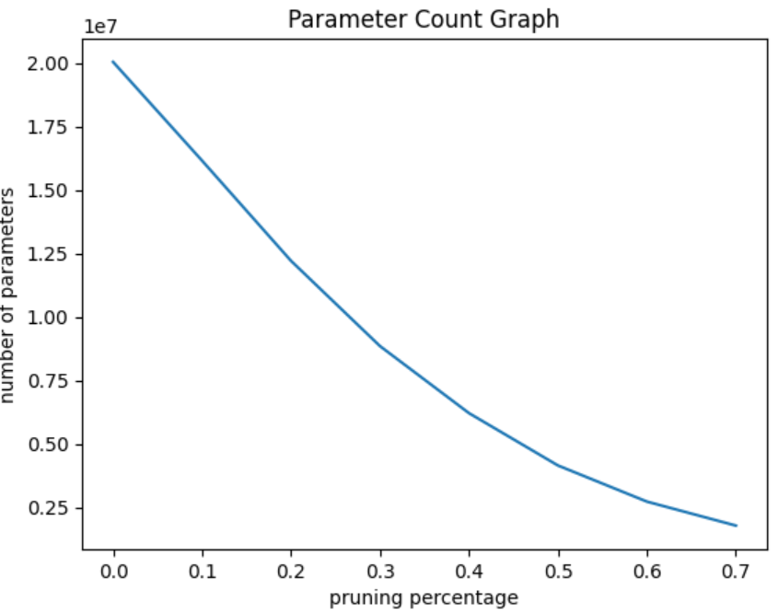
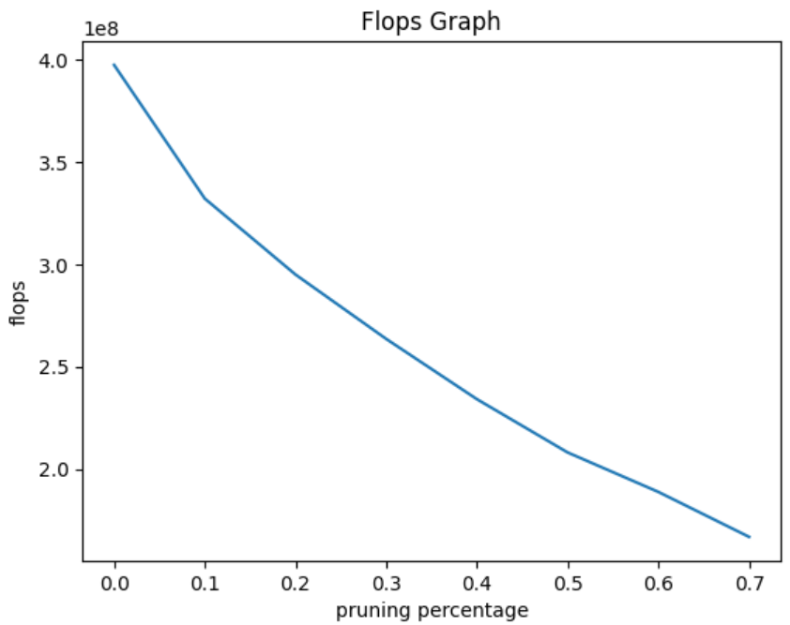
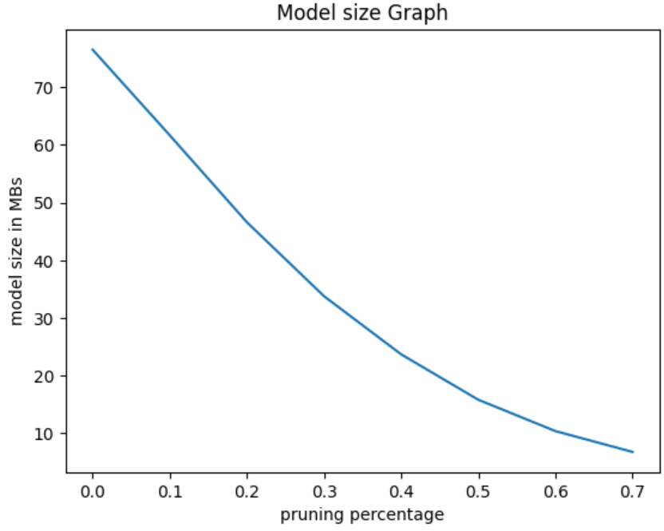
Results on L1 Sparsity Penalty
Figure: Plots of No. of Parameters, Flops and ModelSize w.r.t. Pruning ratio

Slide 12
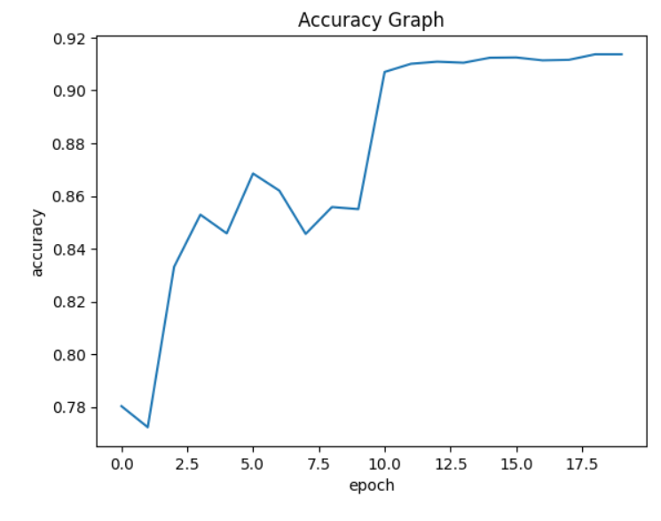
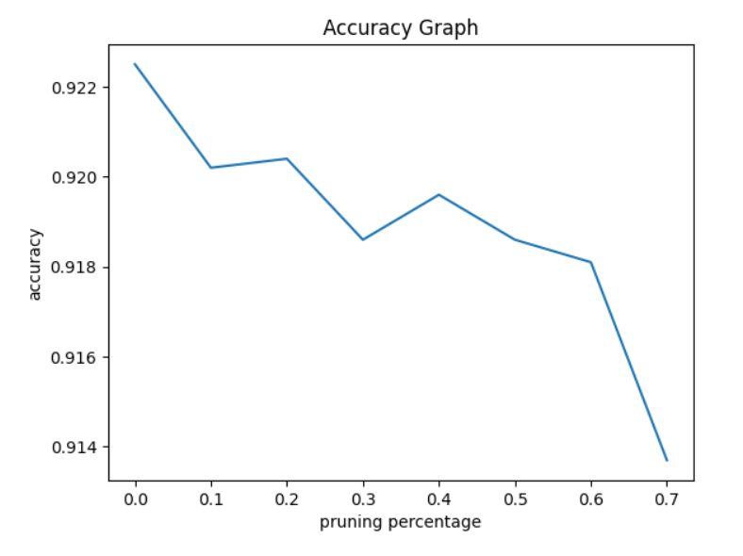
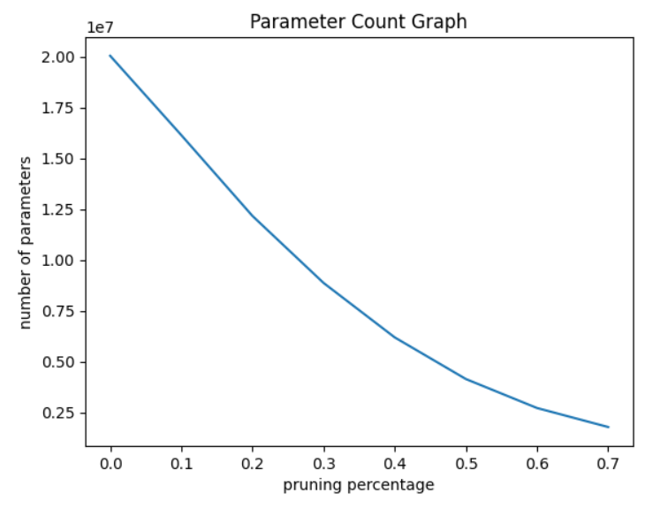
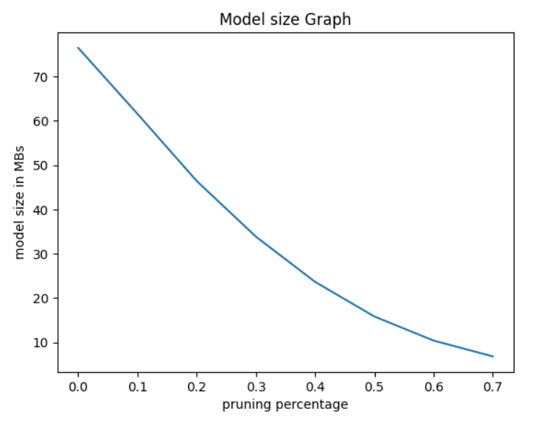
Pruning with Lp regularization
For p = 0.50

Slide 13
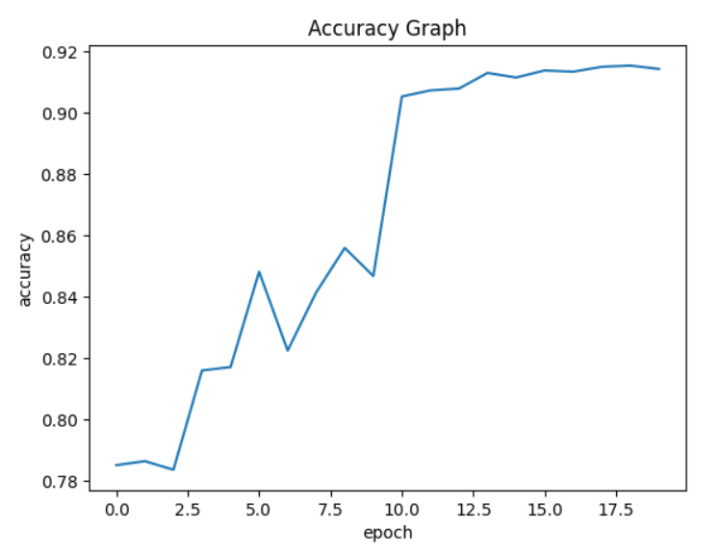
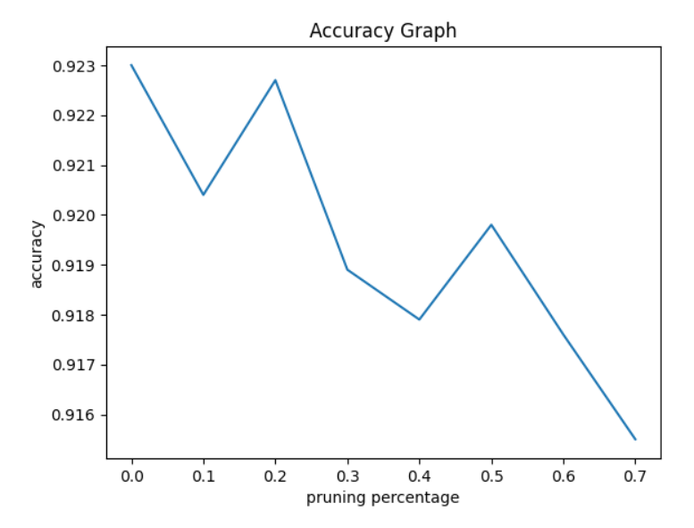
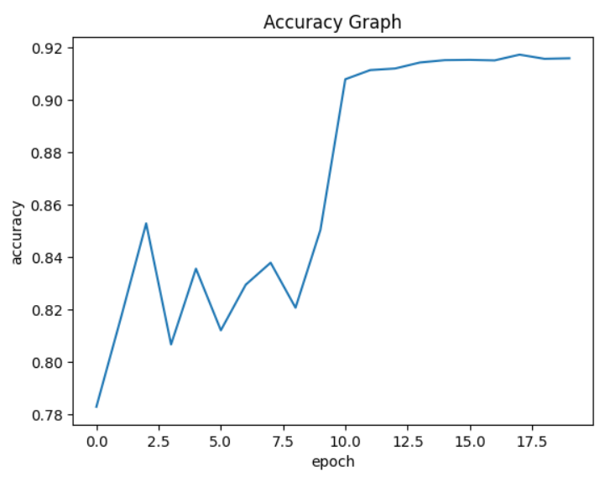
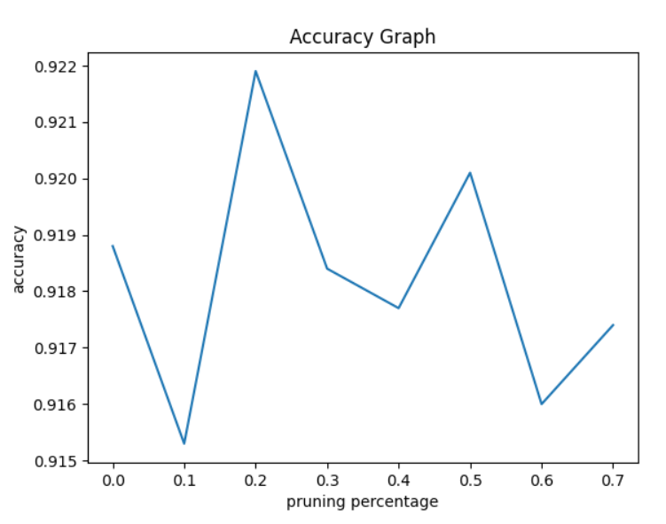
Pruning with TL1 regularization
For a = 1.0
For a = 0.5

Slide 14
Comparison of various Regularization penalties
Regularization Penalty | Acc % (30%) | Acc % (70%) | Params (30%) | Params (70%)
L1 | 91.71 | 91.61 | 8838650 | 1779829
L1/4 | 91.24 | 91.12 | 8835852 | 1775829
L1/2 | 91.86 | 91.37 | 8859907 | 1772747
L3/4 | 91.59 | 91.65 | 8865653 | 1765178
TL1 (a = 1.0) | 91.89 | 91.55 | 8832892 | 1792061
TL1 (a = 0.5) | 91.84 | 91.74 | 8859391 | 1754922

Slide 15
Observations
Channel pruning achieves up to 10x parameter reduction, leading to significant memory savings.
Floating-point operation reductions reach around 50%, indicating substantial computational overhead decrease.
TL1 and L1/2 nonconvex regularization techniques can maintain or improve mean test accuracy compared to L1.
TL1 (a = 1.0) and L1/2 show improved mean test accuracy over L1, highlighting their effectiveness.
L1/4 exhibits decreased test accuracy due to extensive channel pruning, emphasizing pruning percentage impact on model performance with nonconvex regularization.

Slide 16
Conclusion
Introduces sparsity-induced regularization for automatic channel pruning without accuracy loss.
Demonstrates up to 10x reduction in computational costs, decreased model size, and memory requirements.
No significant training overhead; doesn't require specialized libraries or hardware for efficient inference.
TL1, and L1/2 nonconvex regularizers outperform traditional L1, with TL1 preserving accuracy post-retraining and achieving superior compression.

Slide 17
Future-work
Experimentation with Larger Models: Extend method to ResNet and DenseNet to evaluate effectiveness across diverse architectures and datasets.
Exploration with SVHN & CIFAR-100: Assess scalability and performance on CIFAR-100 and SVHN datasets for insights into handling more complex data.
Assessment of Additional Nonconvex Regularizers: SCAD (Smoothly Clipped Absolute Deviation) and MCP (Minimax Concave Penalty)
Optimization for Real-World Deployment: Optimize method for scalability, efficiency, and practical implementation, including enhancements for inference speed and memory usage.

Slide 18
Thank You

Slide 19
Appendix

Slide 20
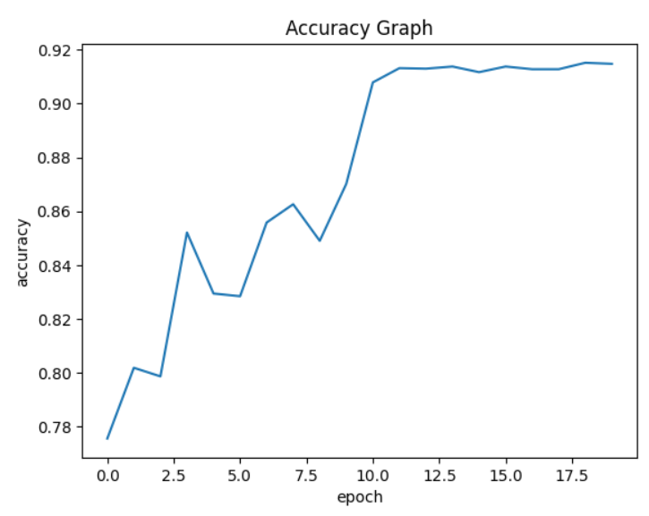
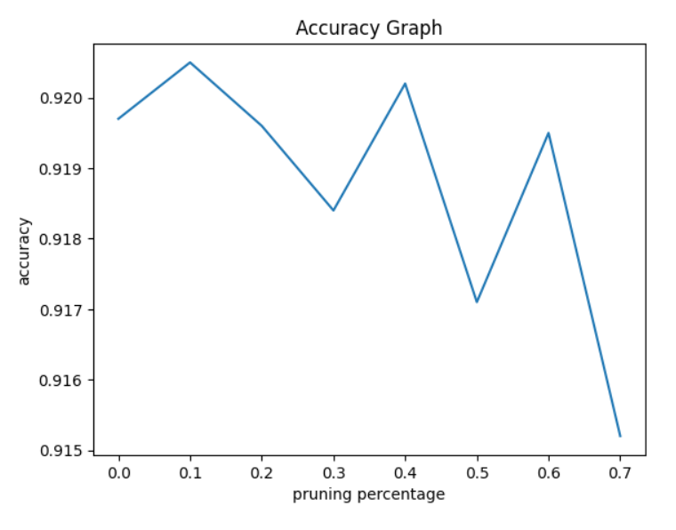
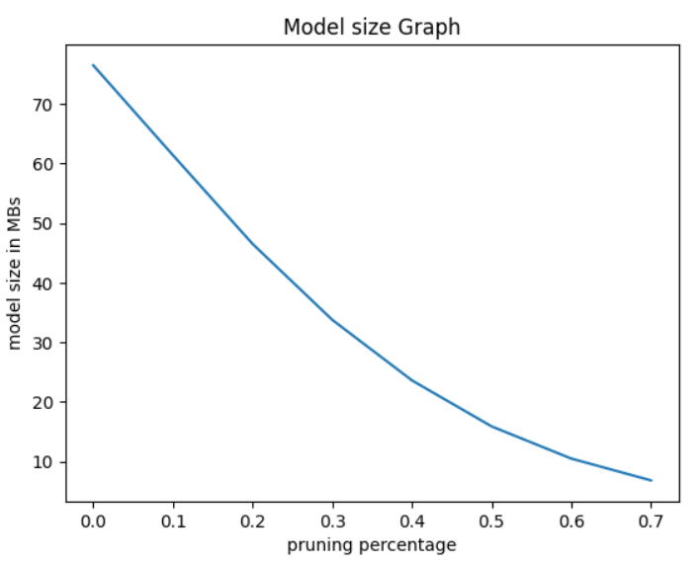
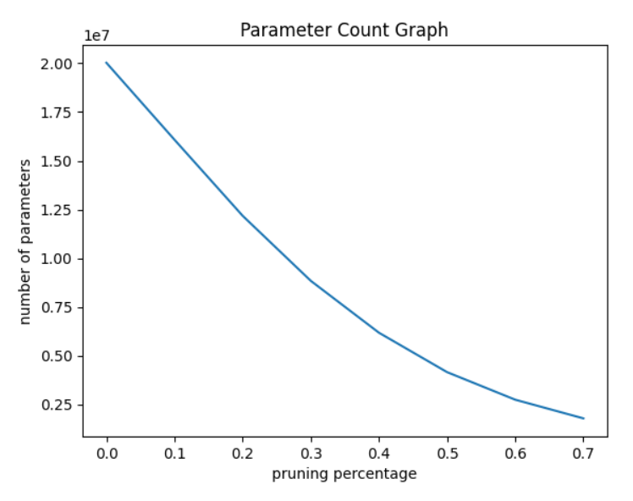
Pruning with Lp regularization
For p = 0.25

Slide 21
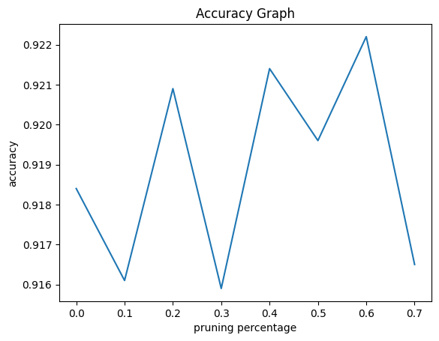
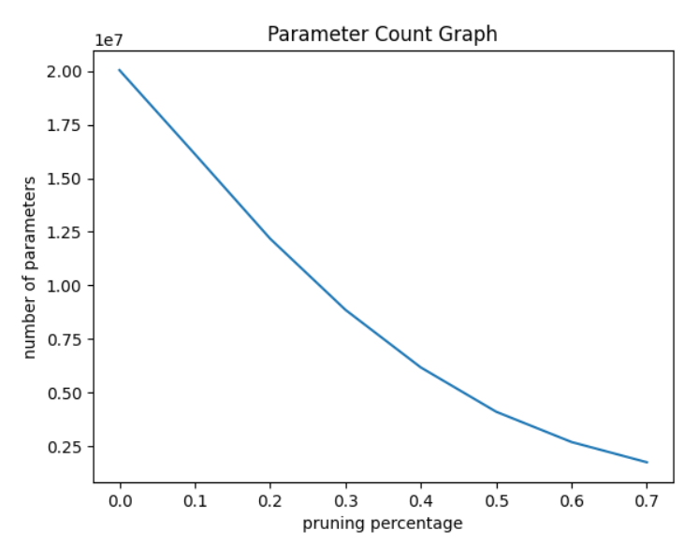
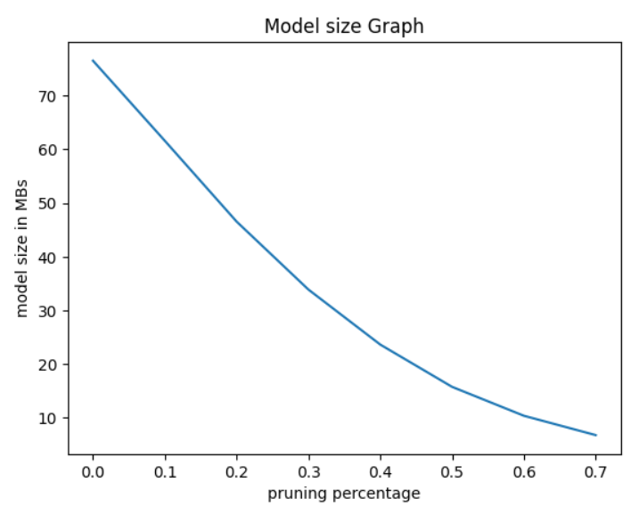
Pruning with Lp regularization
For p = 0.75

Slide 22
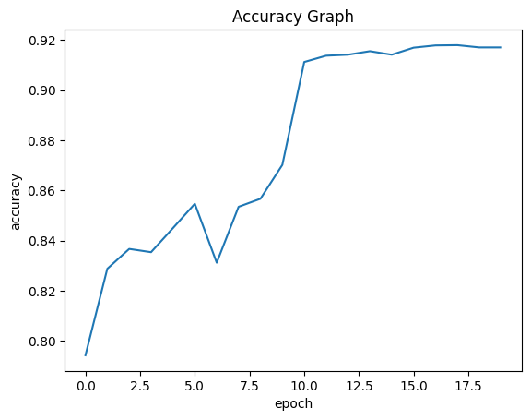
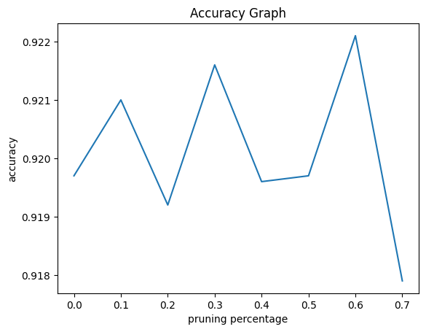
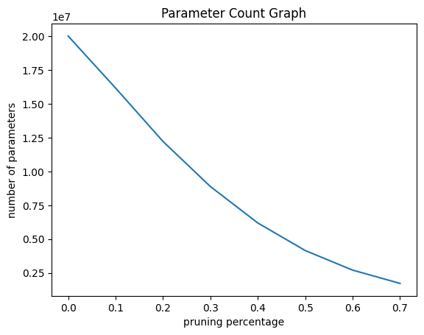
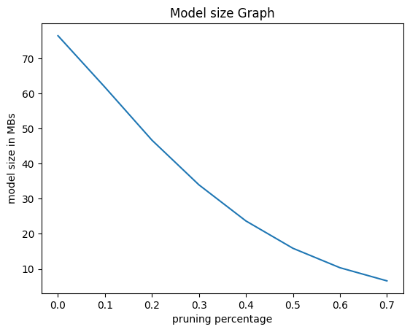
Pruning with Lp regularization
For p = 2.0

Slide 23
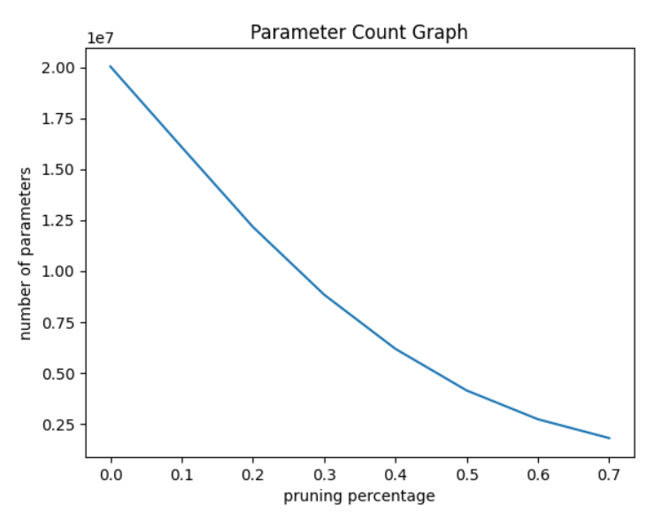
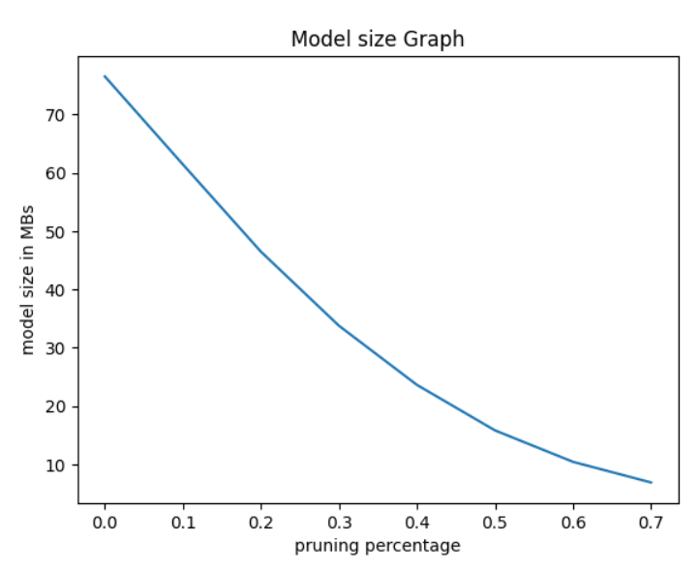
Pruning with TL1 regularization
For a = 1.0

Slide 24
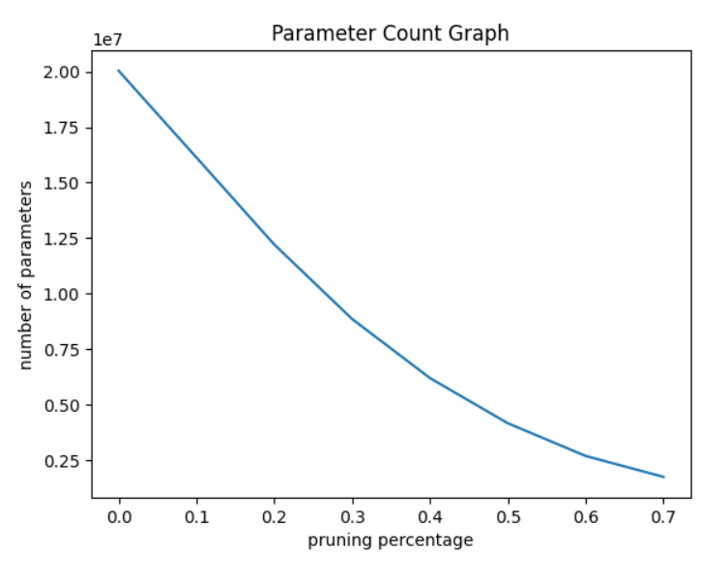
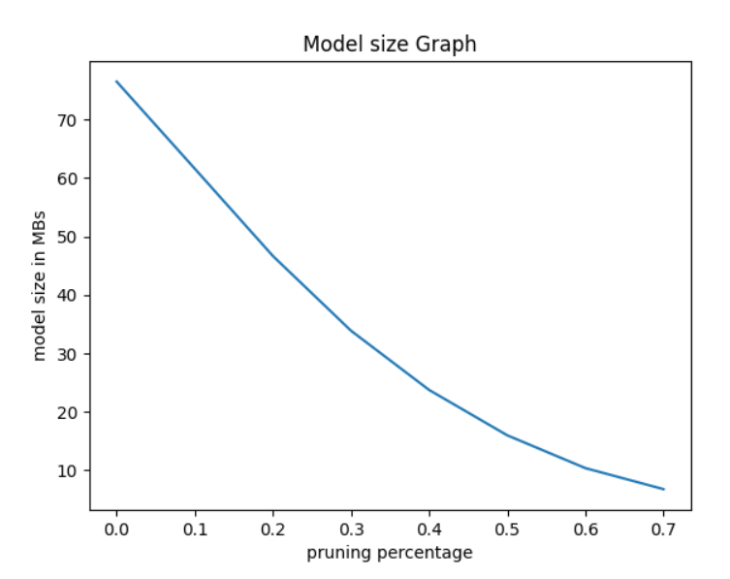
Pruning with TL1 regularization
For a = 0.5

